Slide 1


Slide 2
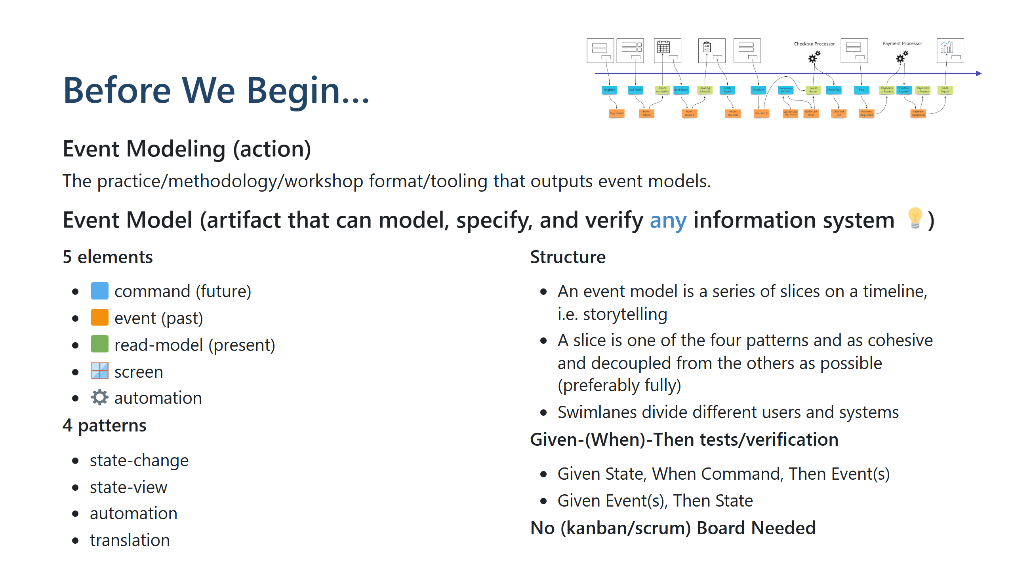

Slide 3
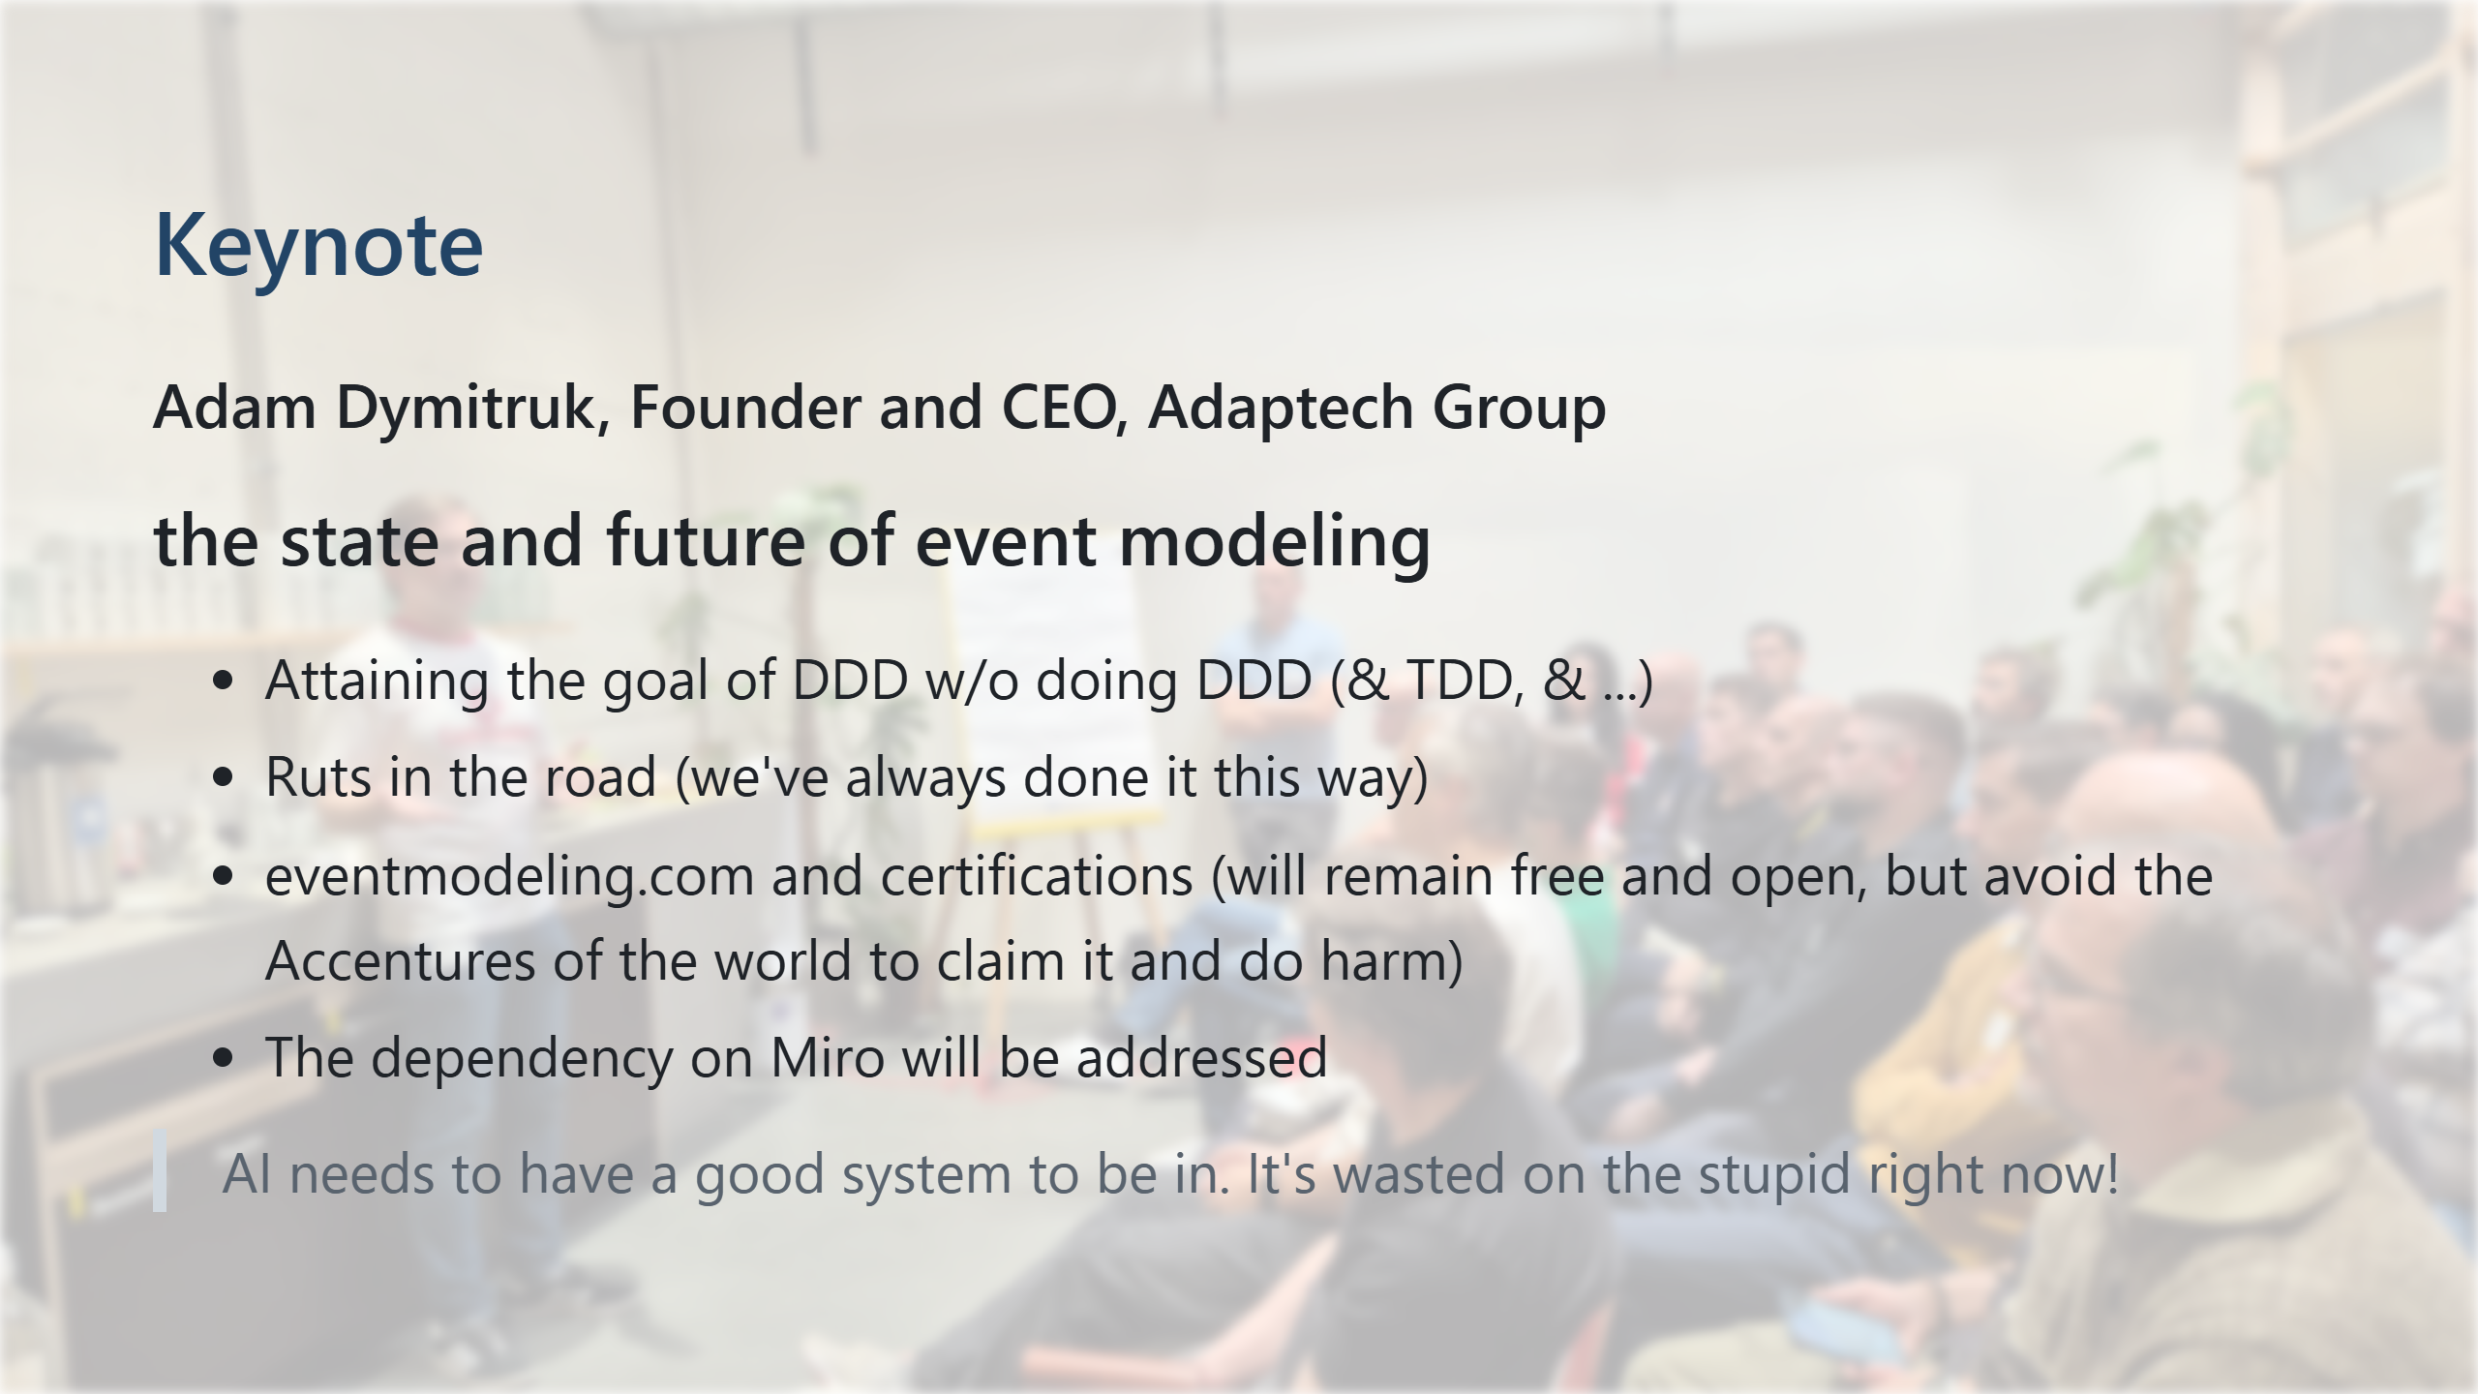
Notes:
the inventor of event modeling and founder and CEO of Adaptech Group

Slide 4
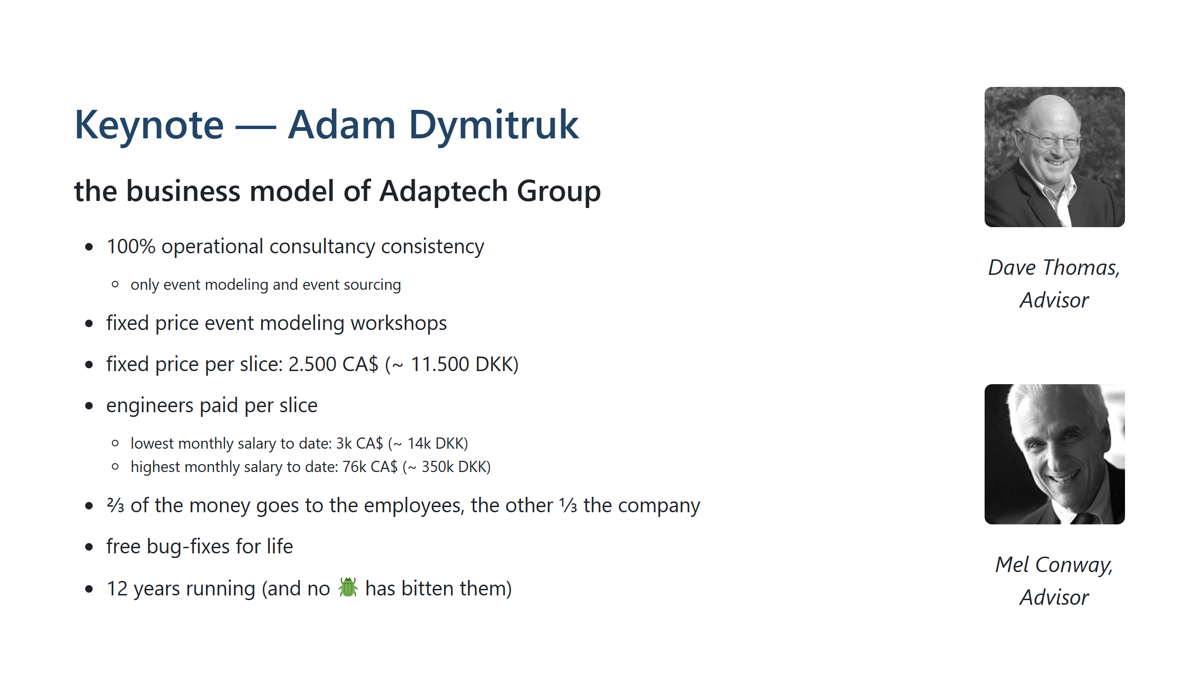

Slide 5
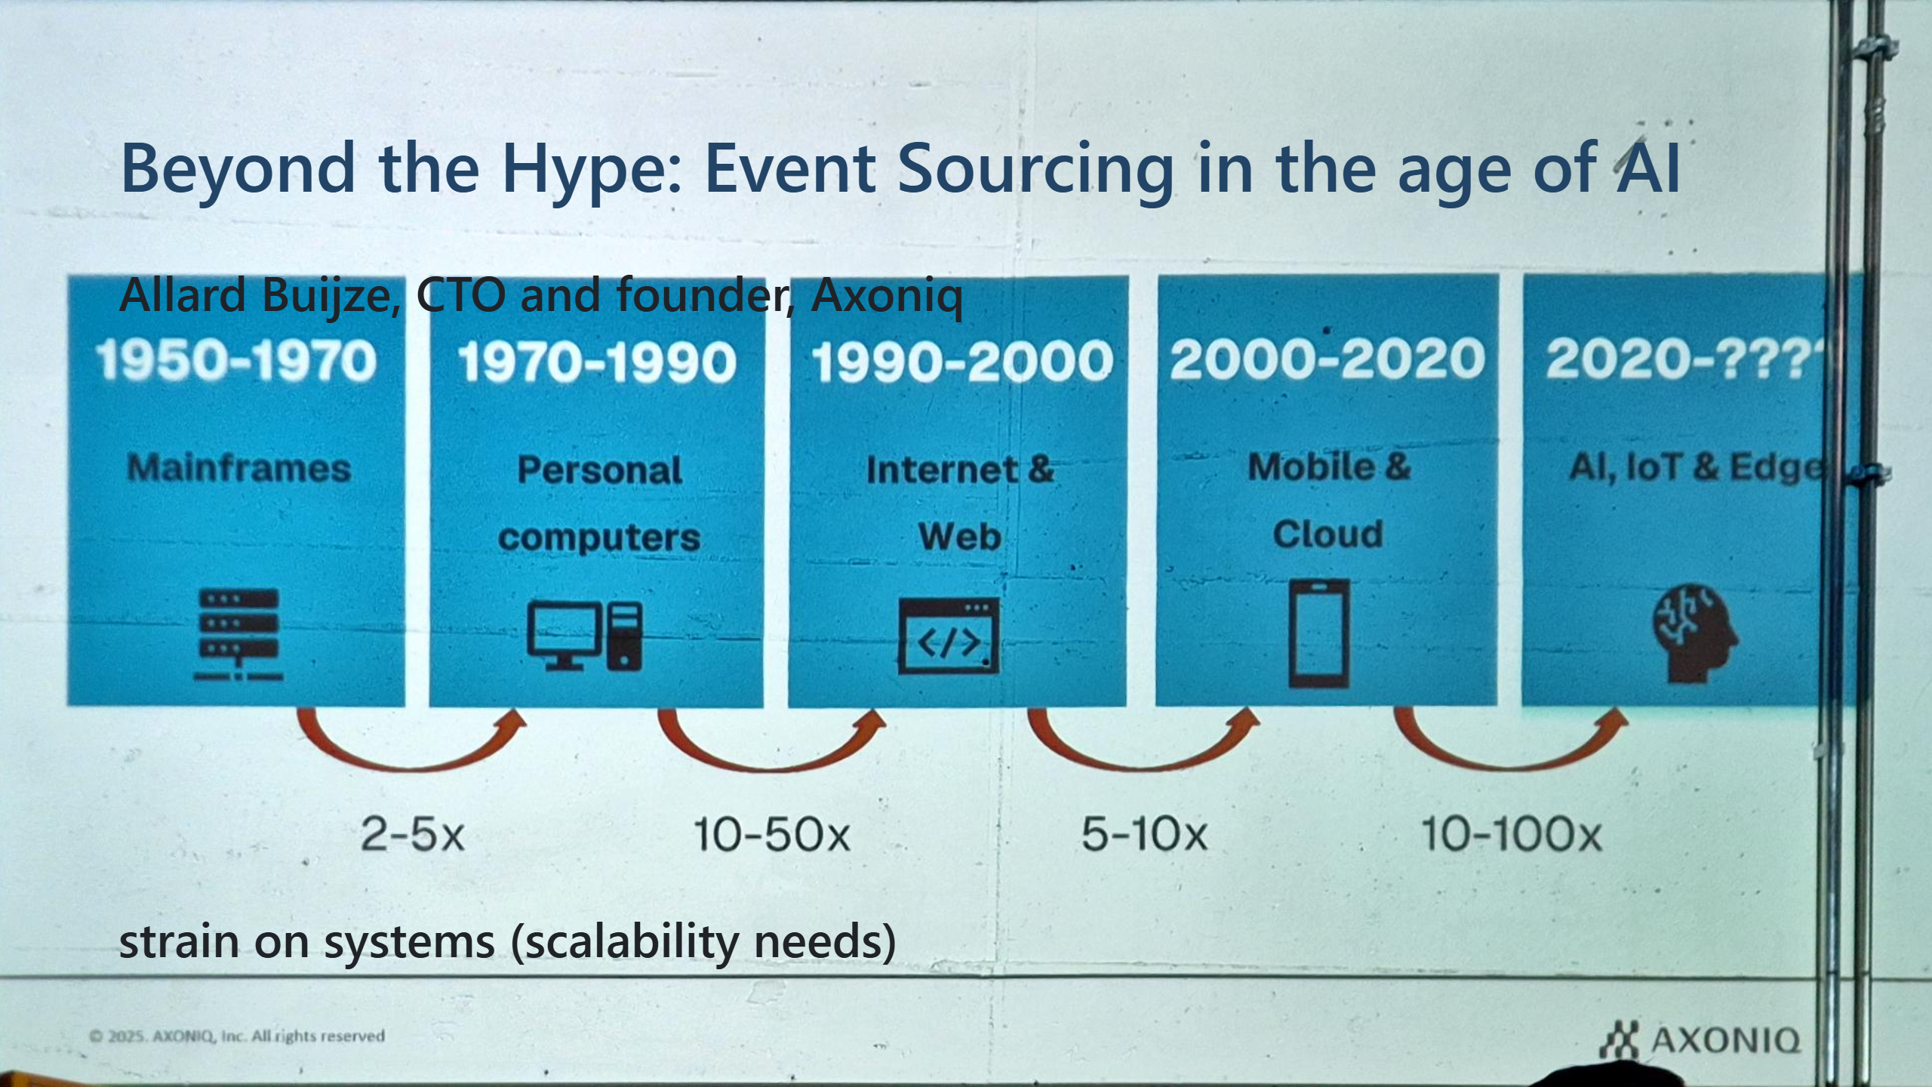

Slide 6
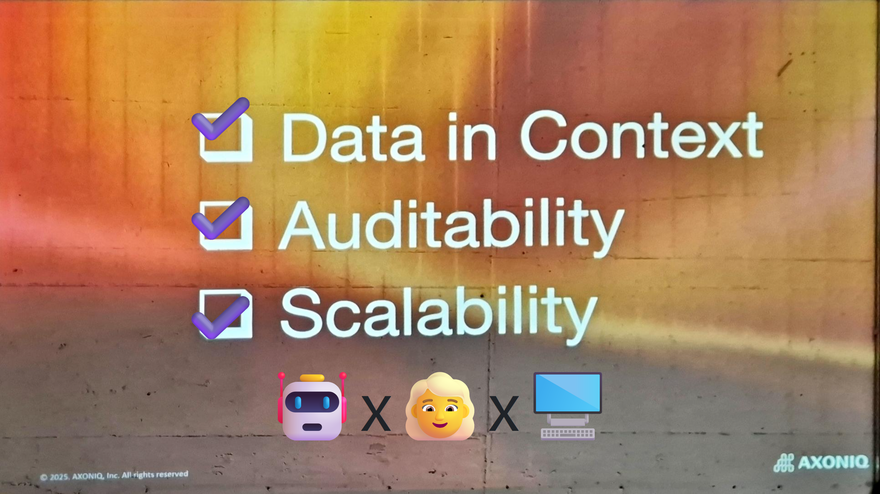

Slide 7
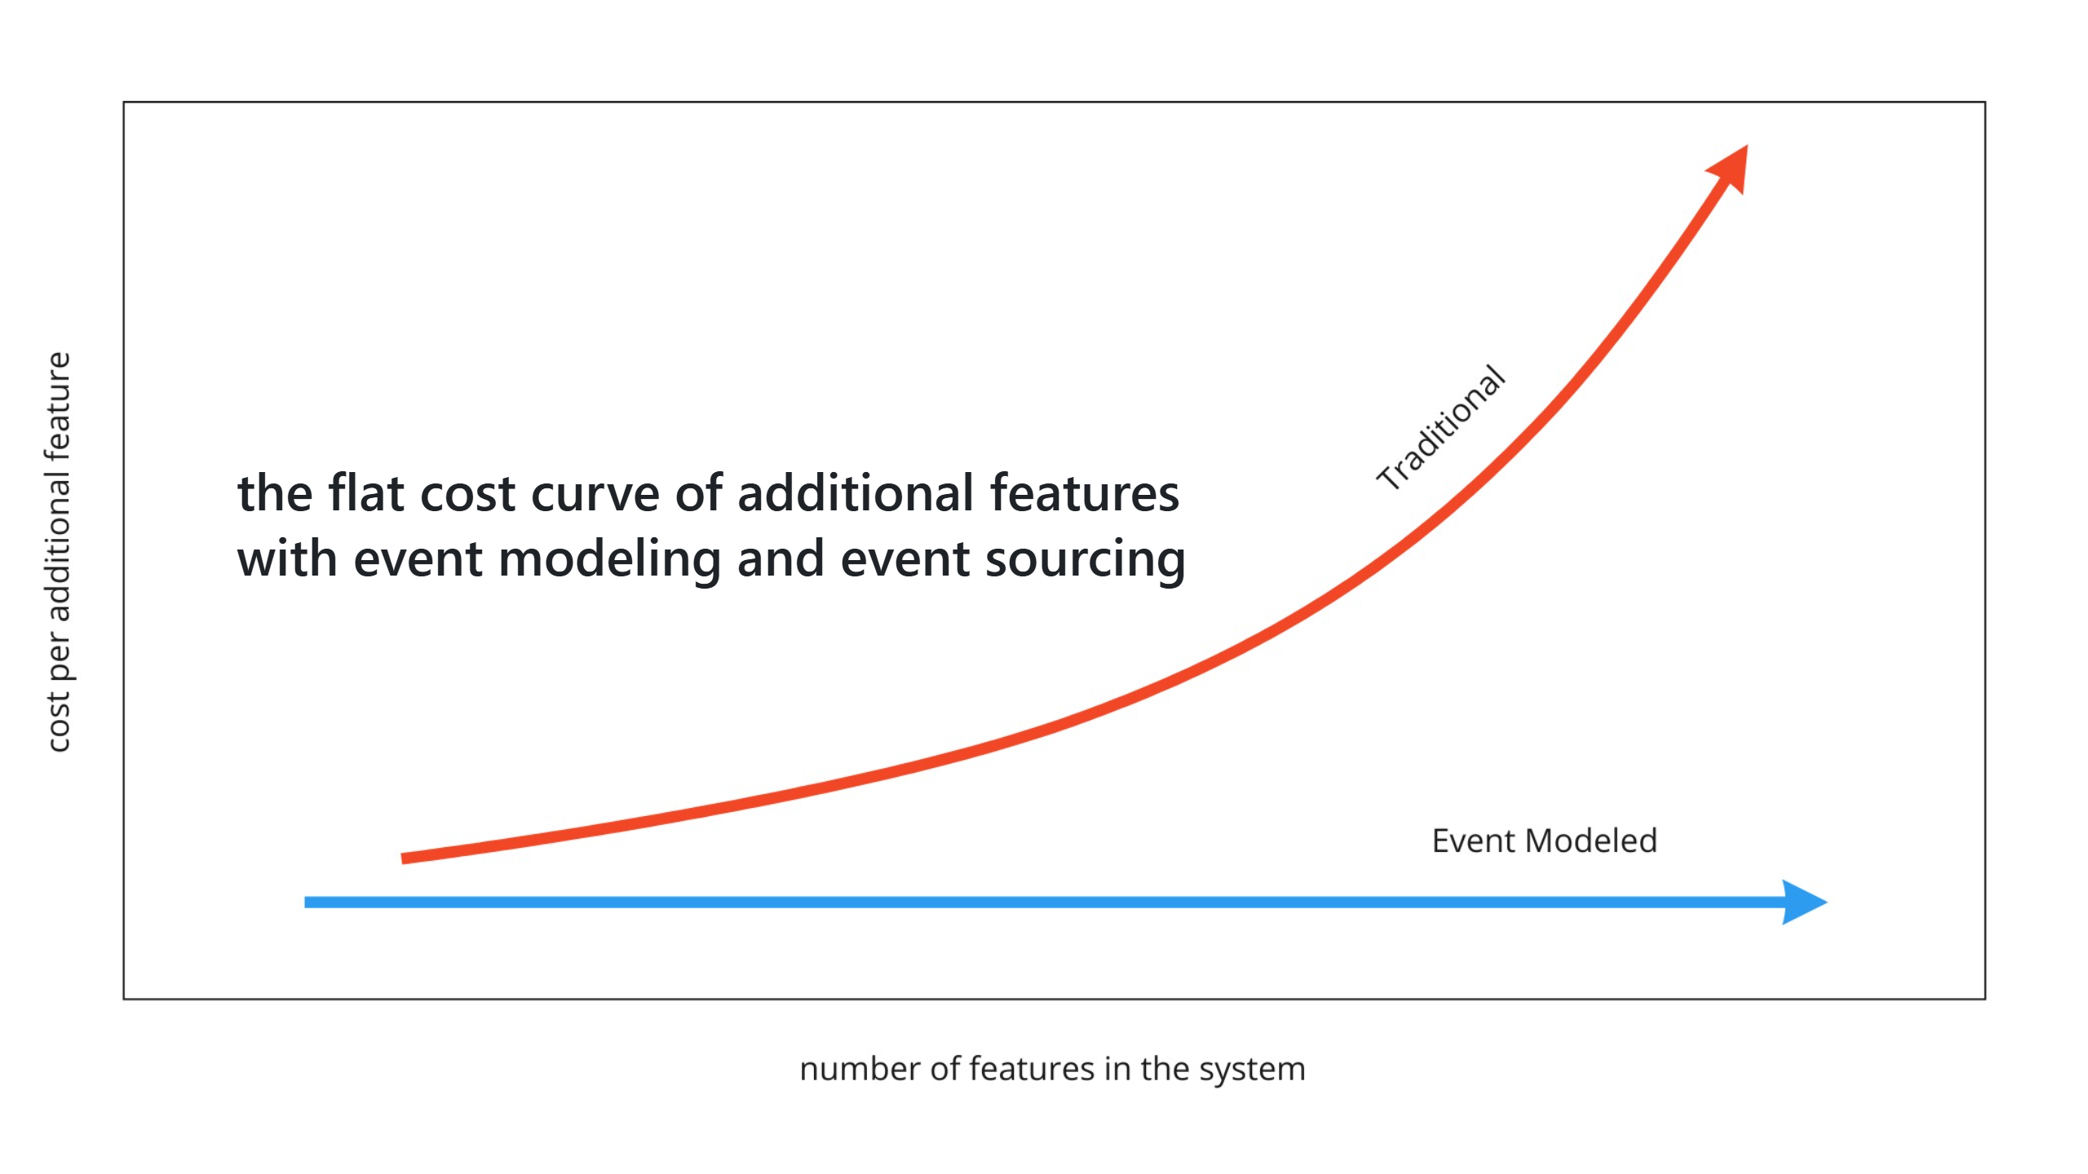

Slide 8
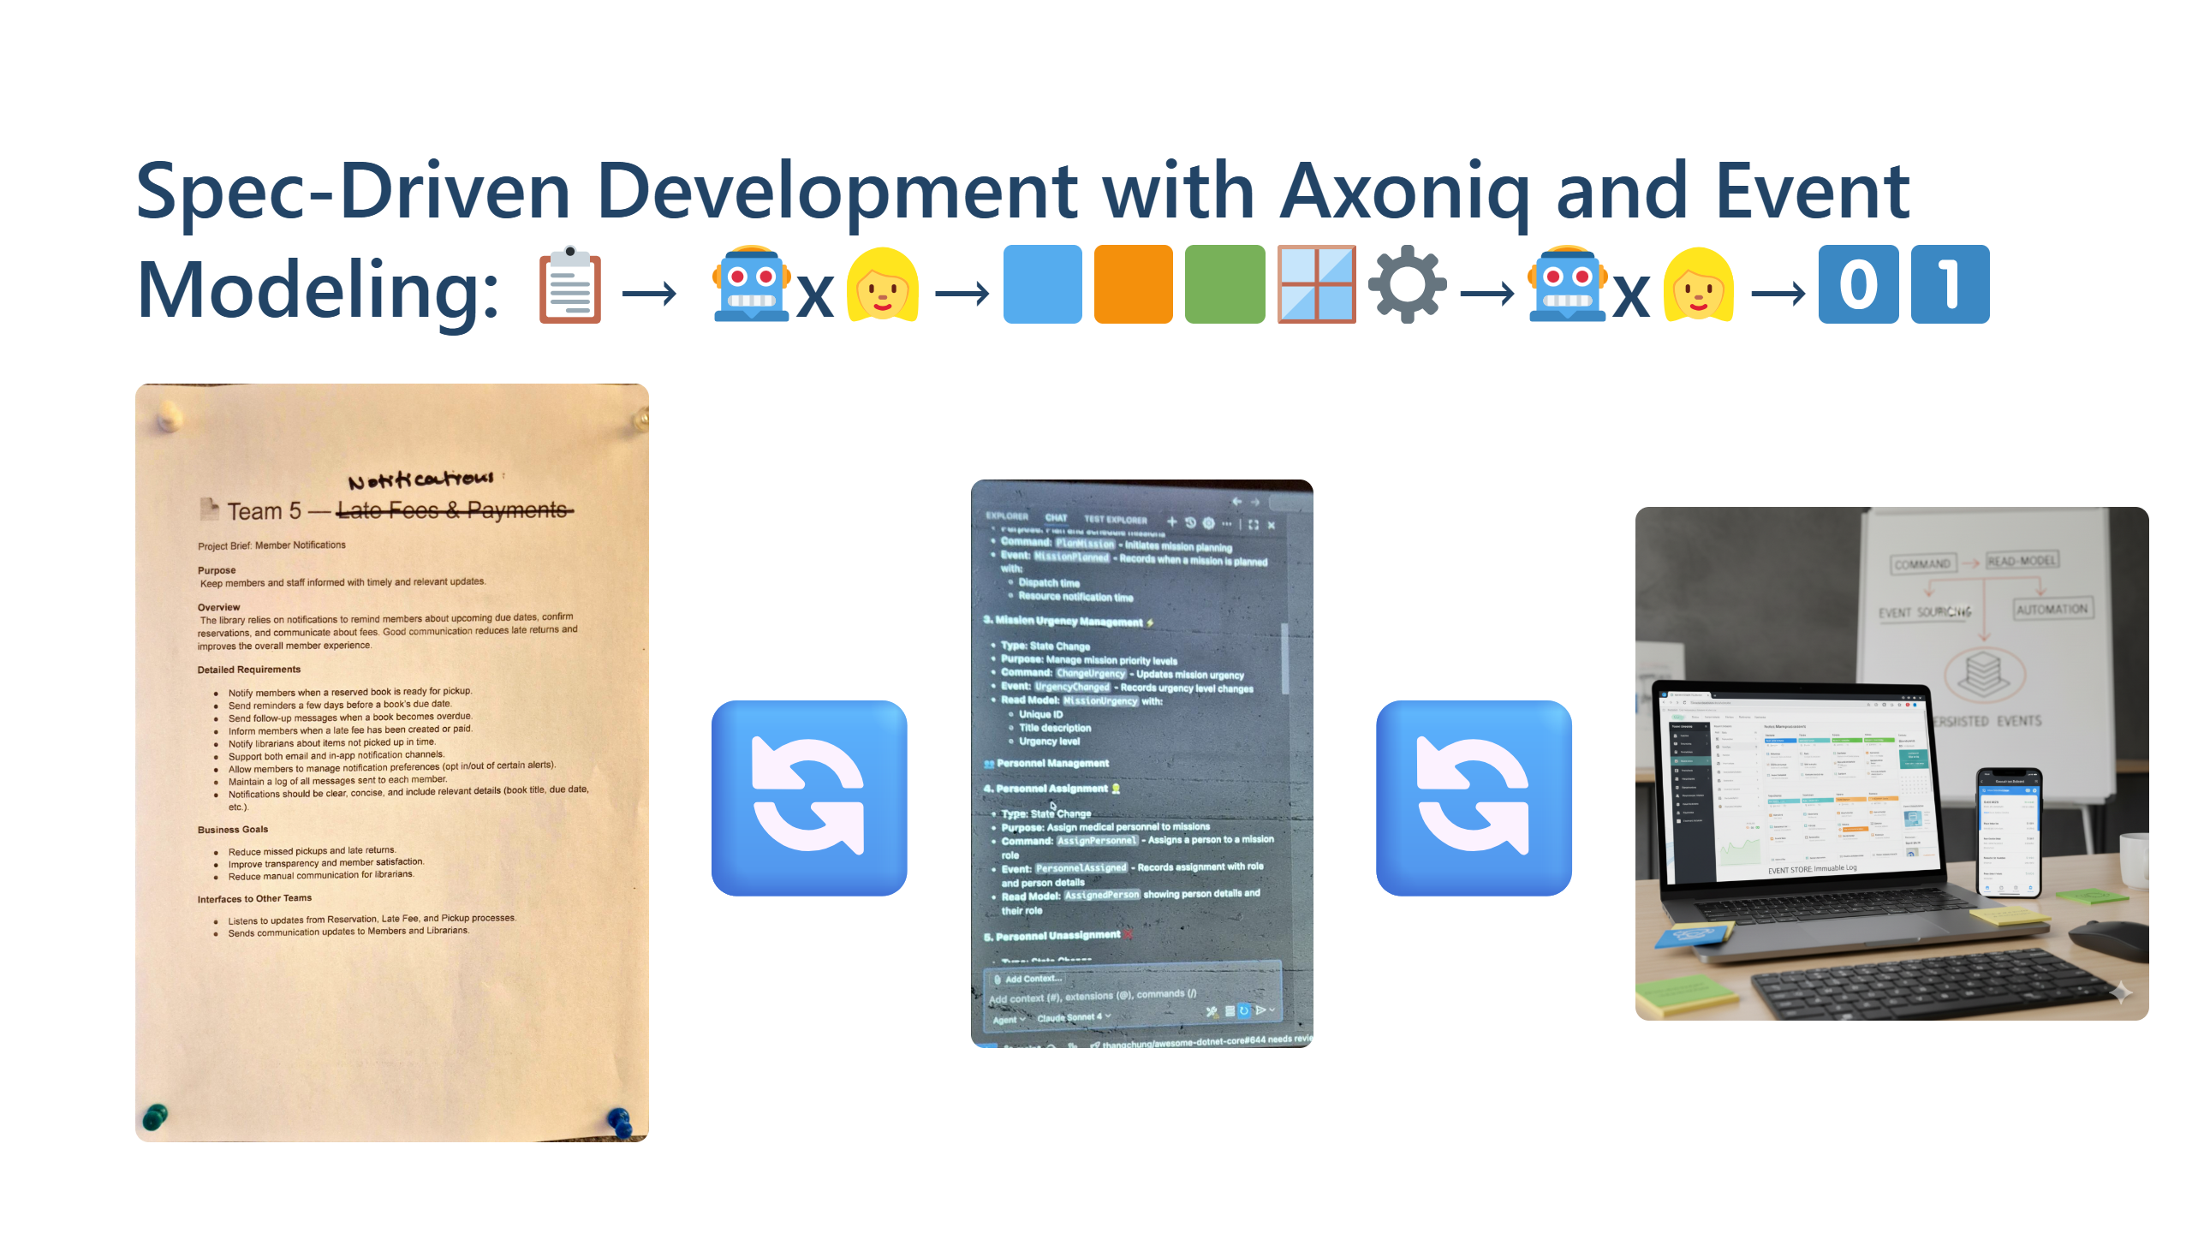
Notes:
The spec was scanned using the phone from a workshop spec at the conference. The event model is text in VSCode. The event model removes the ambiguity. Allard: I don't like event modeling. I love event models. Martin: "Martin, this is the future"

Slide 9
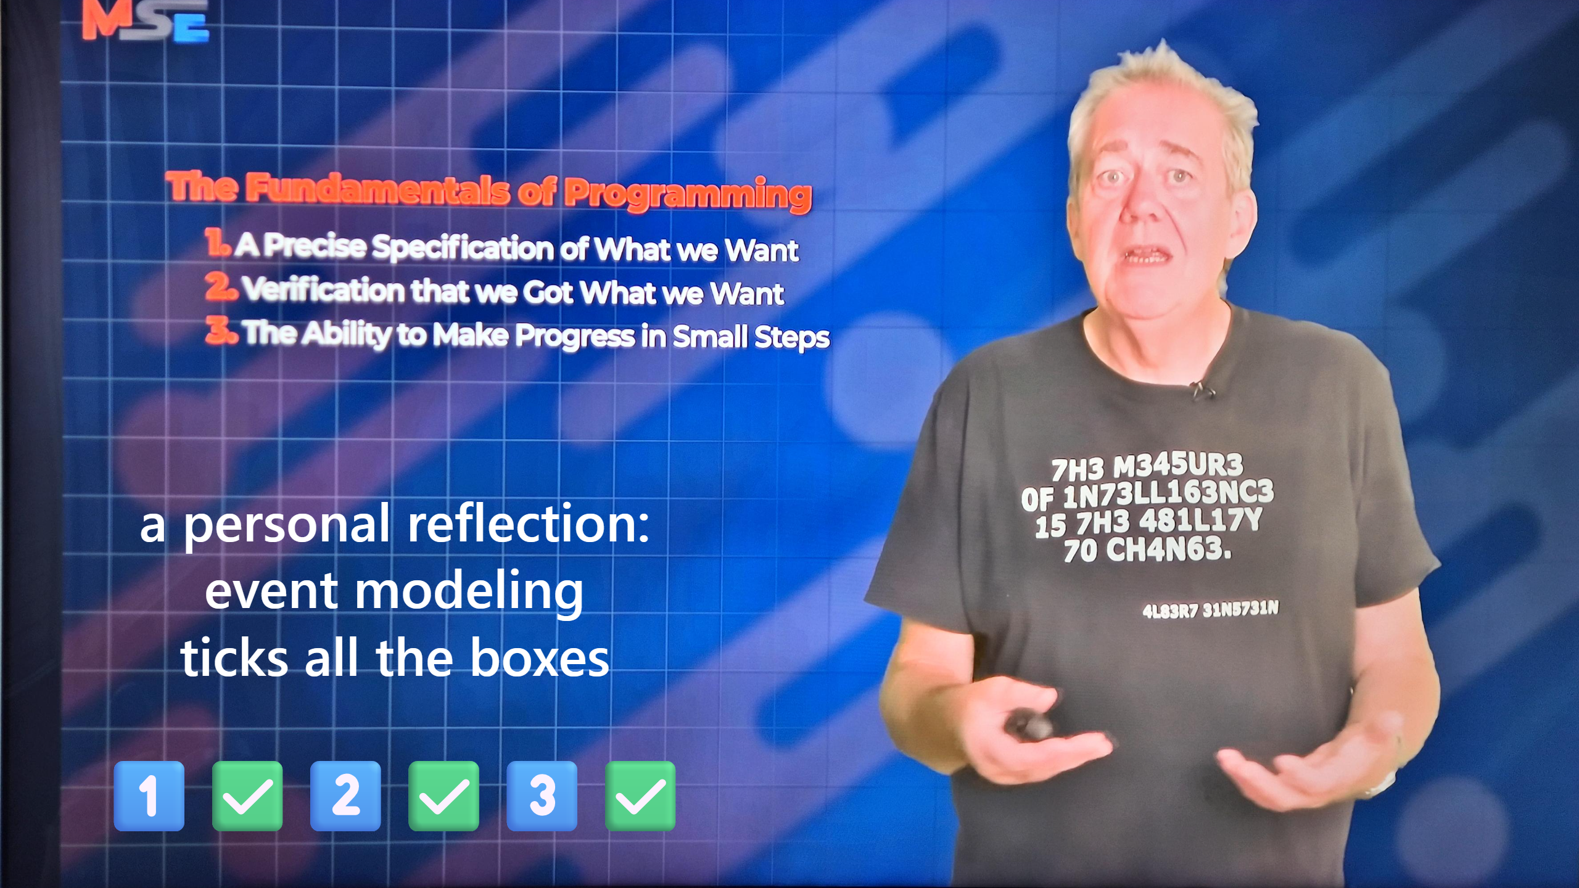
Notes:
https://youtu.be/CoGO6s7bS3A?si=-78edKhlYcBCQ7gg

Slide 10
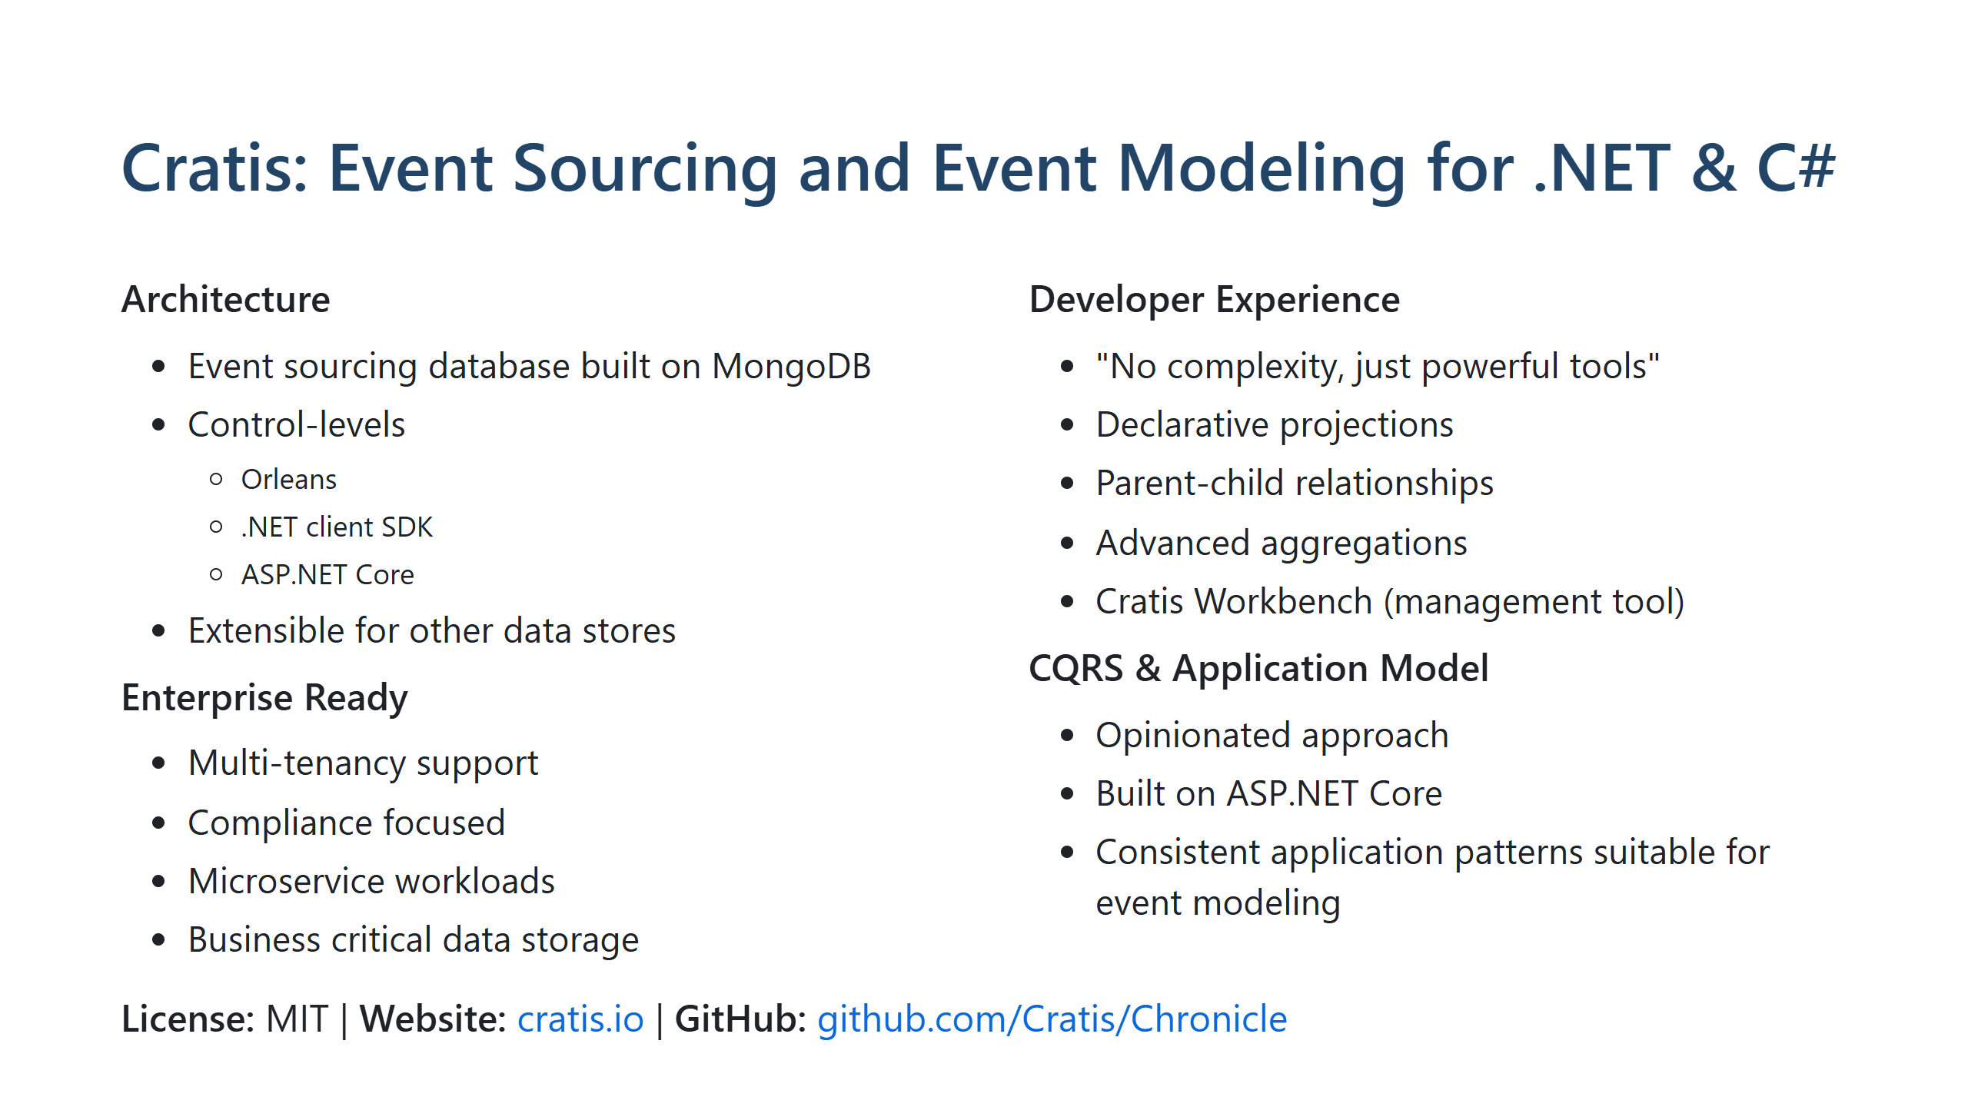
Notes:
research the open source event sourcing and event modeling tool for .net "cratis" and create a slide about it. place the slide last in the slide deck.

Slide 11
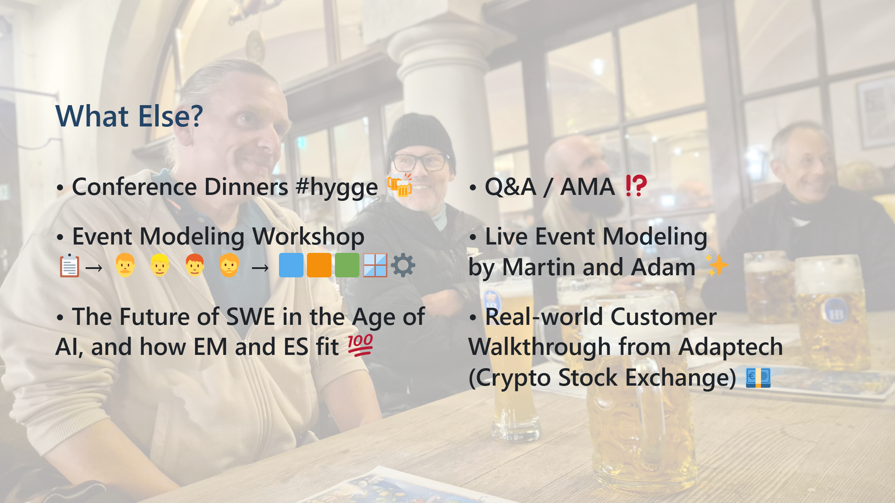

Slide 12
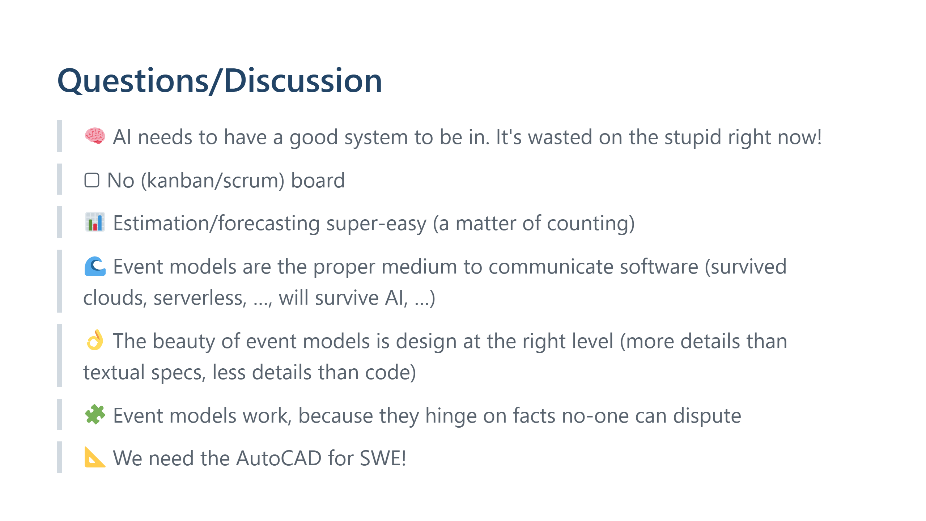
Notes:
provocations, food for thought, idea generators, …

Slide 13
